Slide 1

CREDIT CARD DEFAULT PREDICTION
PRERNA RAI, PRITHA GHOSH, ZEHRA AHMED

Slide 2
PROBLEM STATEMENT
A credit card default occurs when a borrower is unable to make timely payments
Develop several classification models to predict credit card defaulters by using machine learning algorithms
WHAT
WHY
HOW
Identifying customers with a higher risk of default can prevent institutions from issuing credit cards to non-qualifying candidates

Slide 3
DATASET DESCRIPTION
PAYMENT DATA FROM A TAIWAN BANK
Dataset acquired from UCI Machine Learning Repository with data collected from April 2005 through September 2005 (~6 months).
30,000 OBSERVATIONS
Out of which ~6600 observations belong to class of interest
24 FEATURES
Credit Info: Issued Credit Line Limit
Demographic Info: Gender, Education, Marital Status, Age
Payment History: Repayment Status, Bill Amount, Repayment Amount

Slide 4
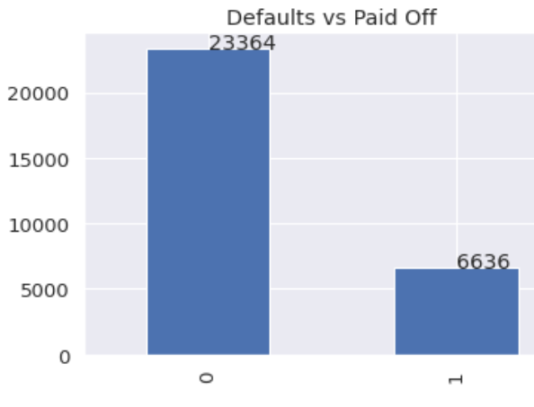
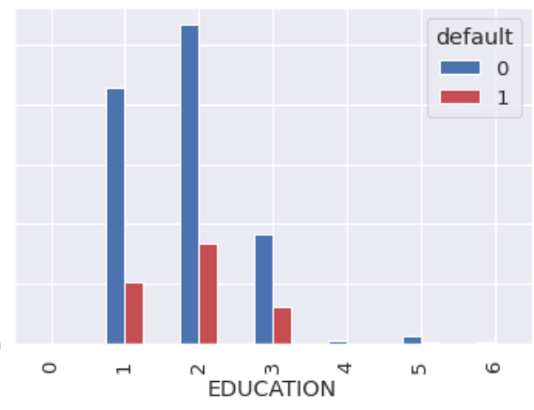
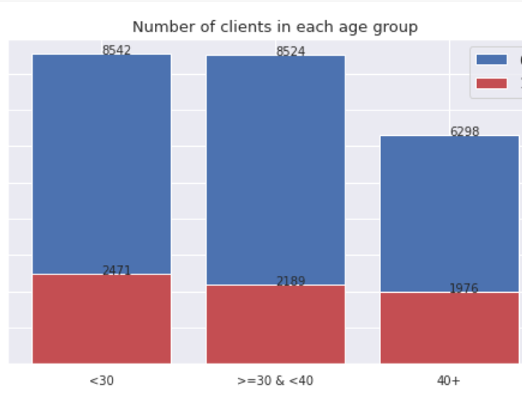
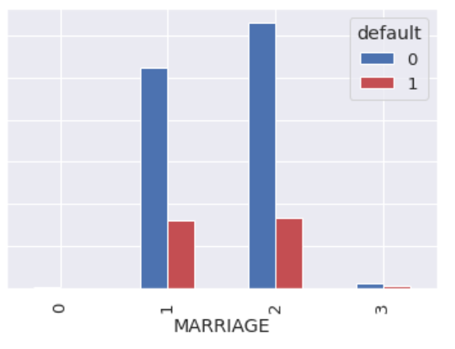
DATA EXPLORATION & PRE-PROCESSING
Dataset is imbalanced with only ~22% observations belonging to class of interest
Performed t-test for difference in means, chi-square test of independence to determine whether a variable is a statistically significant predictor
Grouped EDUCATION into 4 groups – University, Graduate School, High School, Others
Grouped MARRIAGE into 2 groups – Single and Married
Grouped AGE into 3 groups instead of treating it as a continuous variable

Slide 5
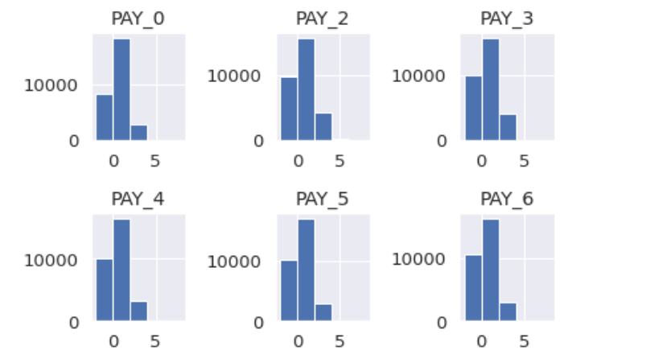
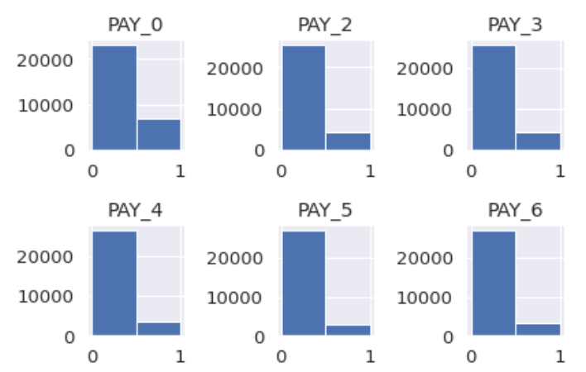
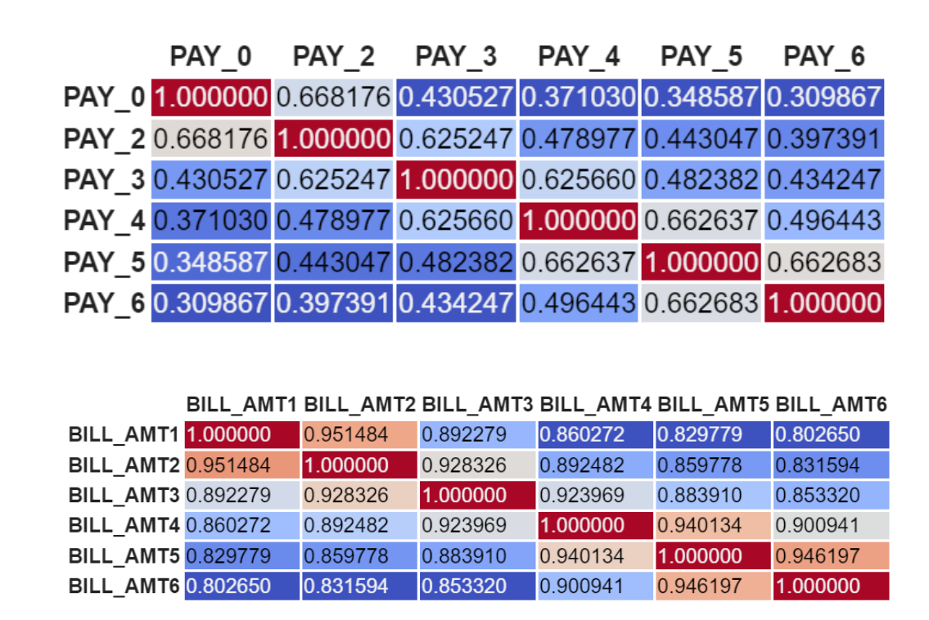
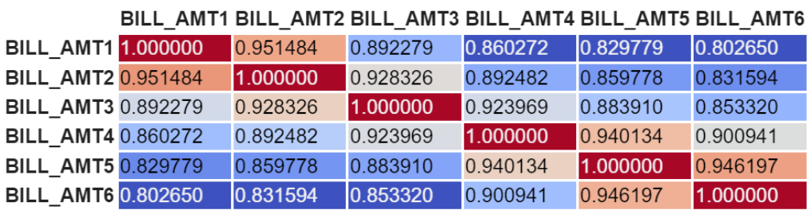
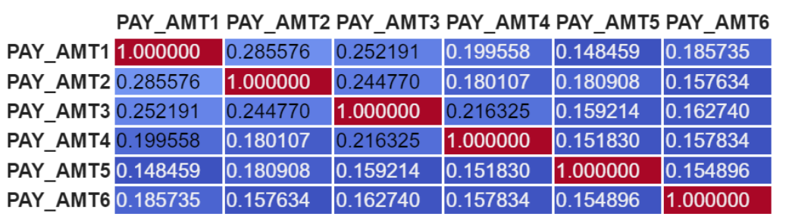
DATA EXPLORATION & PRE-PROCESSING
PAY_0 to PAY_6 : (repayment status) These columns indicate repayment status. We have grouped them into binary 0/1 : Paid On Time/Not Paid On Time
BILL_AMT 1 - BILL_AMT 6: (bill amount) indicates the bill statement for that month
PAY AMT 1 - PAY AMT 6: (repayment amounts) indicates amount of previous payment
Correlation Matrix -> Repayment Status, Bill Amounts and Repayment Amounts are all correlated.
Therefore, instead of using these variables as it is, we have derived new variables that can be used for prediction.

Slide 6
FEATURE ENGINEERING
NUMBER OF MONTHS OF PAYMENT DELAYS
The number of times a customer has delayed payments.
Attributes used:PAY_0 to PAY_6 columns, which indicate repayment delay
AVERAGE CREDIT UTILIZATION
Average of bill amount divided by the available credit limit each month.
Attributes used: BILL_AMT1 to BILL_AMT6 fields, which denote the credit card bill amount
PAID OFF PERCENTAGE
Ratio of the total amount of credit card bill paid off and the total amount of expenses incurred on the credit card
Attributes used: PAY_AMT1 to PAY_AMT6 and BILL_AMT1 to BILL_AMT6

Slide 7
DATA CLEANING STEPS
REMOVAL OF HIGHLY CORRELATED VARIABLES
STANDARDIZATION OF NUMERIC FEATURES
We have normalized the numeric features using the StandardScaler() function from the sklearn package. It standardizes the features by removing the mean and scaling to unit variance.
ONE HOT ENCODING OF CATEGORICAL VARIABLES
We have also performed one-hot encoding on the categorical variables in order to convert them into numerical before using them in our prediction models

Slide 8
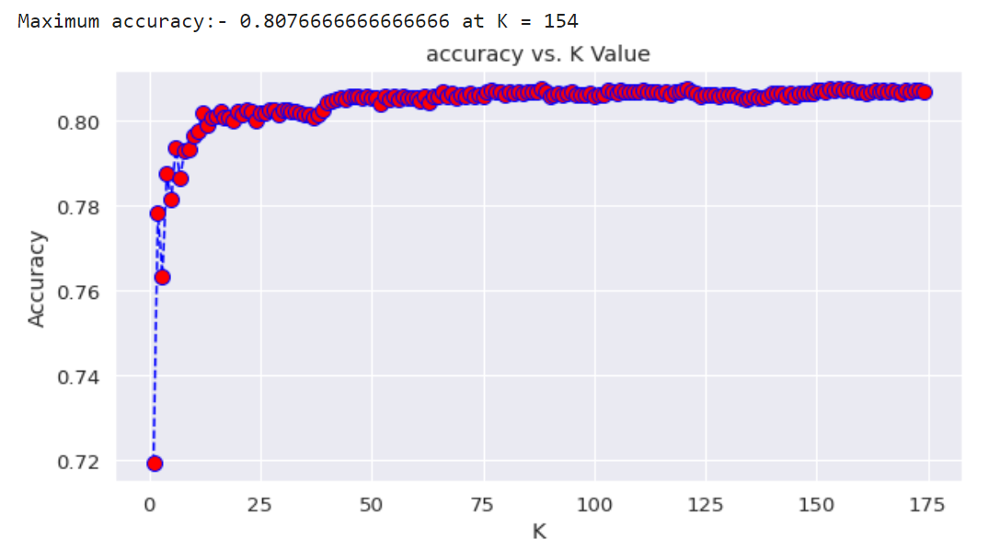
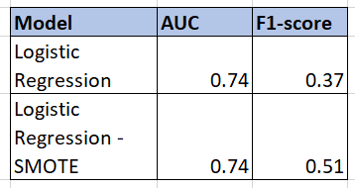

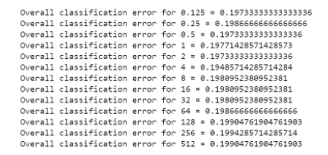
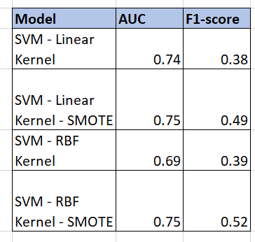
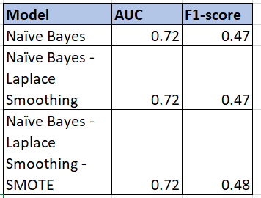
MODEL EVALUATION AND COMPARISON
KNN
Optimal k-value : 154
LOGISTIC REGRESSION
Penalty: L2
SVM
MODELS
NAÏVE BAYES

Slide 9
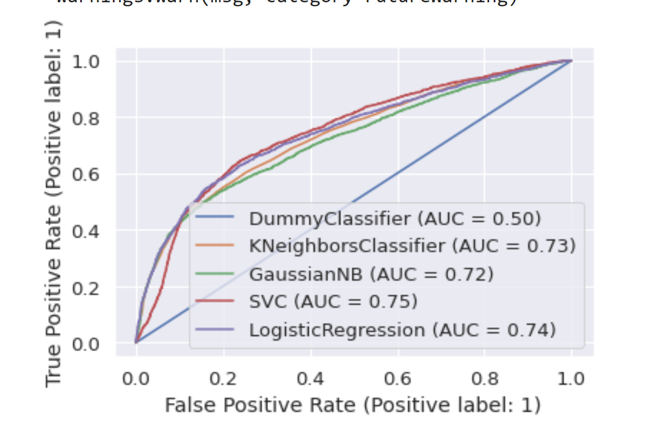
KEY INSIGHTS
Since our dataset is imbalanced, applying oversampling techniques like SMOTE helped in improving the predictive performance of the models.
Compared to the AUC of the baseline model at 0.5, the AUC improved to 0.75
The SVM classifier with the radial kernel performed best in terms of AUC value and F1 score, followed by Logistic Regression, KNN and finally Naïve Bayes
Although a properly tuned radial kernel performs slightly better than a linear kernel, it takes more resources and a longer time to train. Therefore, it may not be suitable for large datasets

Slide 10
FUTURE CONSIDERATIONS
Optimize the models to maximize profit by changing the classification thresholds – with lower thresholds, the model allows more credit cards to be issued whereas with higher thresholds, the model is more conservative and will not issue credit cards unless there is a high probability that the customer will be able to repay the bill.
Experiment with other over and under sampling techniques to see improvement in performance.
Experiment with other standardization techniques to see if it improves the performance of the model.
Incorporate other algorithms beyond the current scope of the class, like Random Forests and Gradient Boosting Methods.
Apply unsupervised learning algorithms and evaluate their performance.

Slide 11
THANK YOU!

